Slide 1
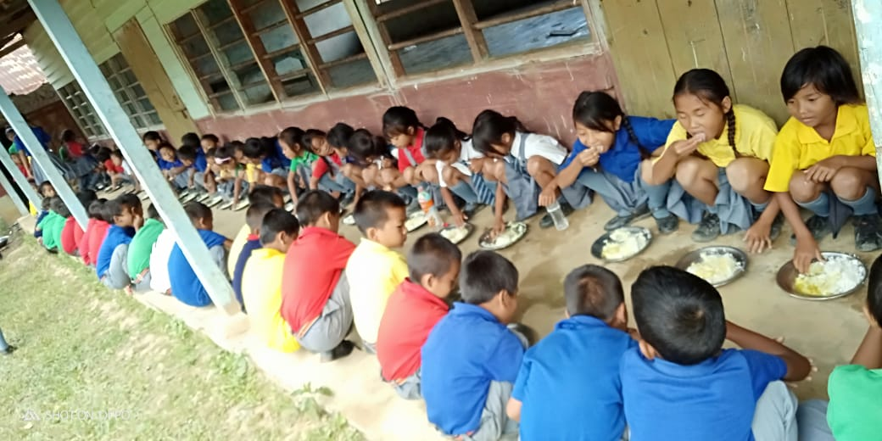
Mid Day Meal
in
Nagaland

Slide 2
Institutions & Enrolment
Sl. No. | INDICATORS | STATUS
1. No. of Institutions |  | PRY | U PRY | TOTAL
i) | Existing Institutions | 1134 | 965 | 2099
ii) | Covered during the year | 1134 | 965 | 2099
2. No. of Children
i) | Approved by MDM-PAB | 122117 | 41584 | 163701
ii) | Enrolment as on 30.9.2018 | 126767 | 41571 | 168338
3. Proposal for 2019-20 (As per UDISE 2017-18)
i) | Institutions | 1134 | 965 | 2099
ii) | No. of Children | 127936 | 39598 | 167534

Slide 3
Activities Undertaken in 2018-19
Capacity Building & Sensitization done at all levels –
IEC activities taken up
- Flexi Banners of MDMS put up in all districts/blocks & schools
- Radio Jingles produced to be broadcasted in FM Stations
- YouTube videos produced on the Scheme
65.36% e-transfer of honorarium done for CCHs
Kitchen gardens provided with farm tools for 194 schools through the State and financial assistance of Rs.10,000/- per school were given to 107 for organic school garden under RMSA.
Monitoring strengthened by involving Student Organizations under the Monitoring & Supervision Unit of the scheme.
Water bottles provided to all children and double fortified salt issued to all the schools.

Slide 4
Proposed Activities in 2019-20
MDM Melas to be organized in all the districts under 5% Flexi Fund.
Channelize efforts on encouraging more community participation – probability of a boost in local economy
Engage 3rd Party for Assessment of the Scheme
IEC Plan to be strengthened
Conduct re-orientation programs at all the levels
Strengthen convergence with line departments like H&FW, PHE, Social Welfare etc.
Strengthen Monitoring of the scheme by utilizing the AEOs/SMDCs/SMCs

Slide 5
Requirement of Store-cum-Kitchen
Kitchen-cum-Stores, an immediate requirement!
1777 facilities constructed during 2006-07 @ Rs. 60,000/facility with locally available resources
Most of the kitchens in dilapidated conditions or non-existent.
Storage of food items a problem in such conditions and bound to be unsuitable for consumption if kept even for some days
Only around 500 store-cum-kitchens constructed in phases using RCC materials
The state proposes construction of 845 kitchen-cum-stores with an estimated cost of Rs. 8516.54 Lakhs during the year – a separate proposal submitted.

Slide 6
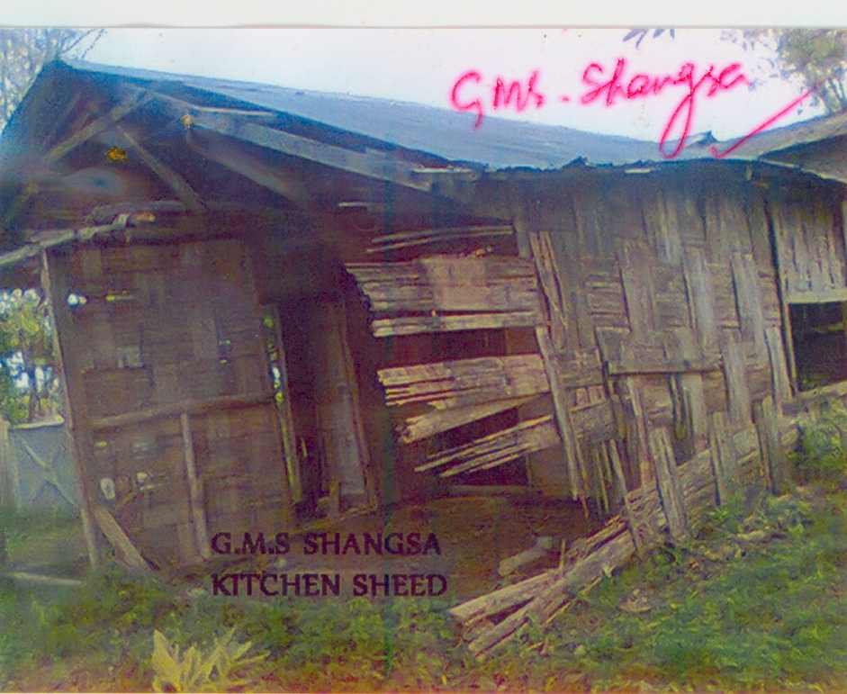
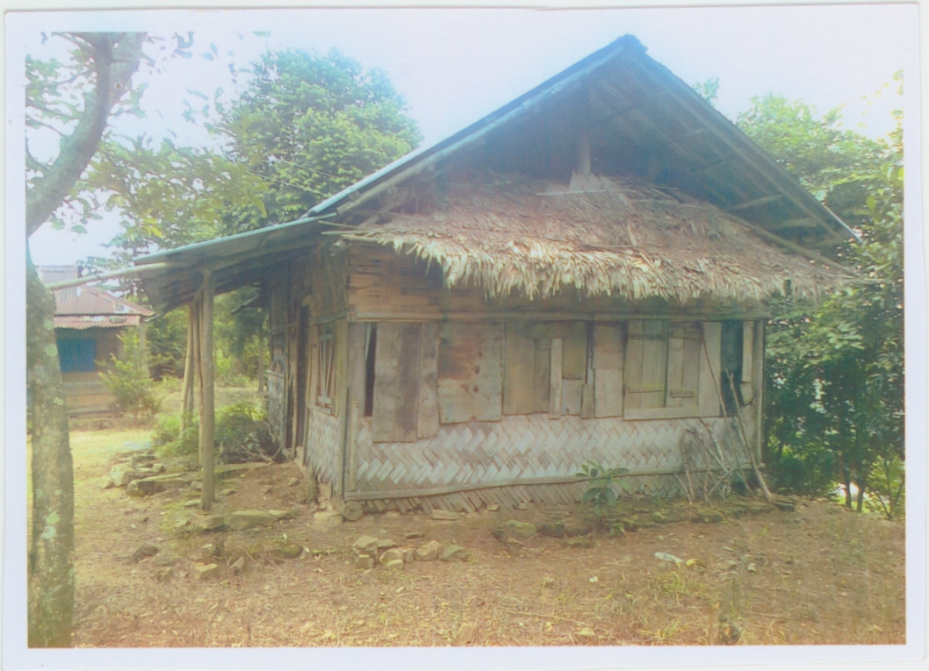
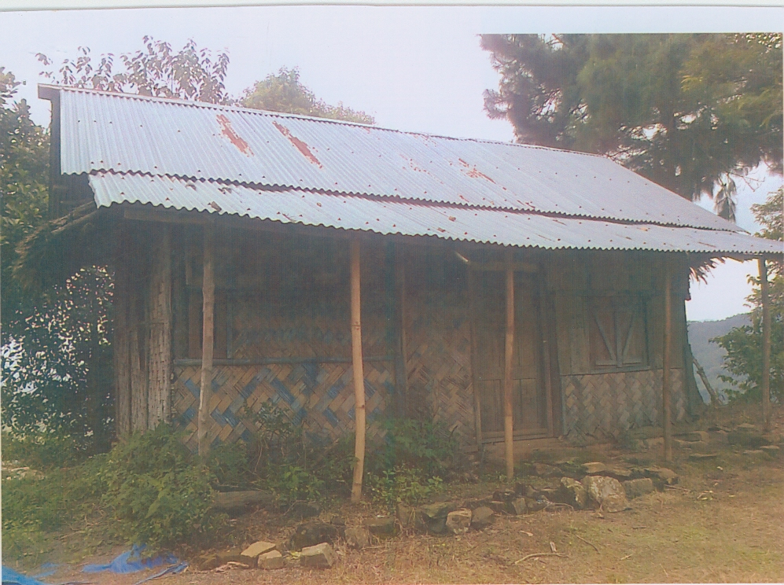
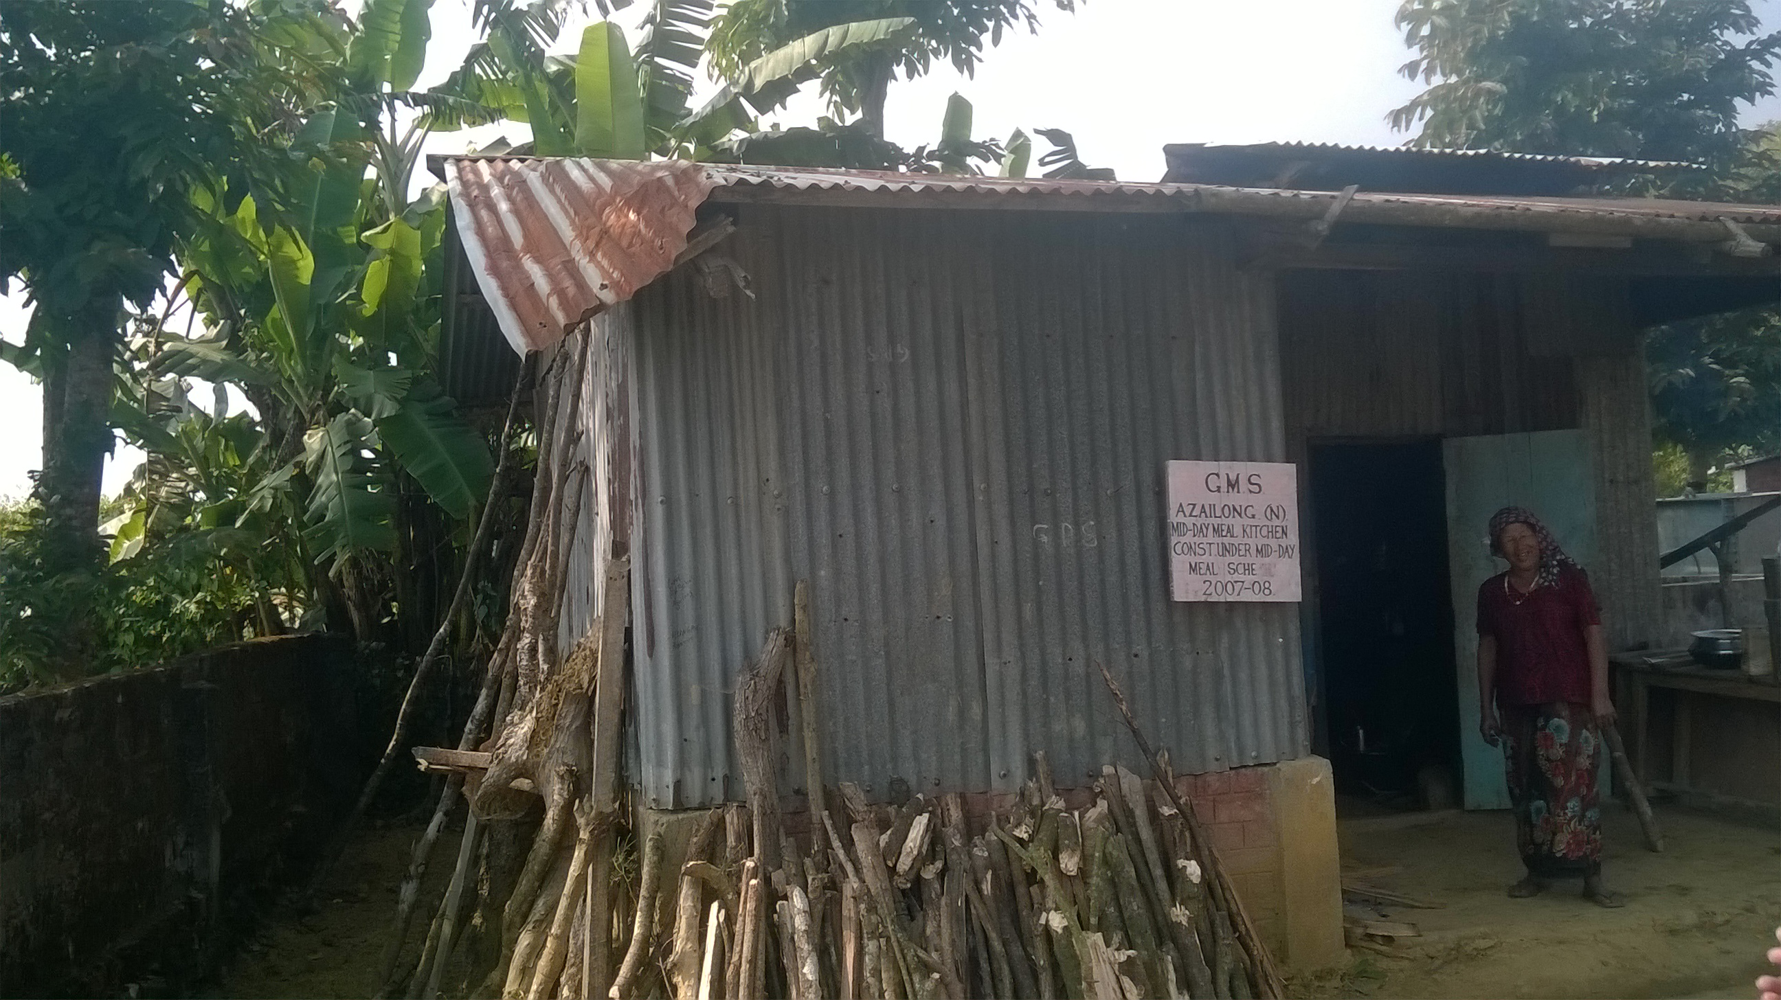
Requirement of Kitchen-cum-Store

Slide 7
Other Issues
Enhancement in Cooking cost:
Cooking costs @ Rs. 4.35 & Rs. 6.51 for Primary and Upper-Primary insufficient to provide wholesome meals
Enhancement in Cook Honorarium:
Retention of trained & dependable cooks is an issue due to the meagre honorarium; trainings cannot be imparted every time they are replaced.
Enhancement in MME Fund Allocation:
Employing capable personnel for smooth functioning deliberately overlooked owing to insufficient fund allocation under MME.
Important activities like monitoring, training etc., cannot be done as expected or desired due to fund constraints under MME

Slide 8
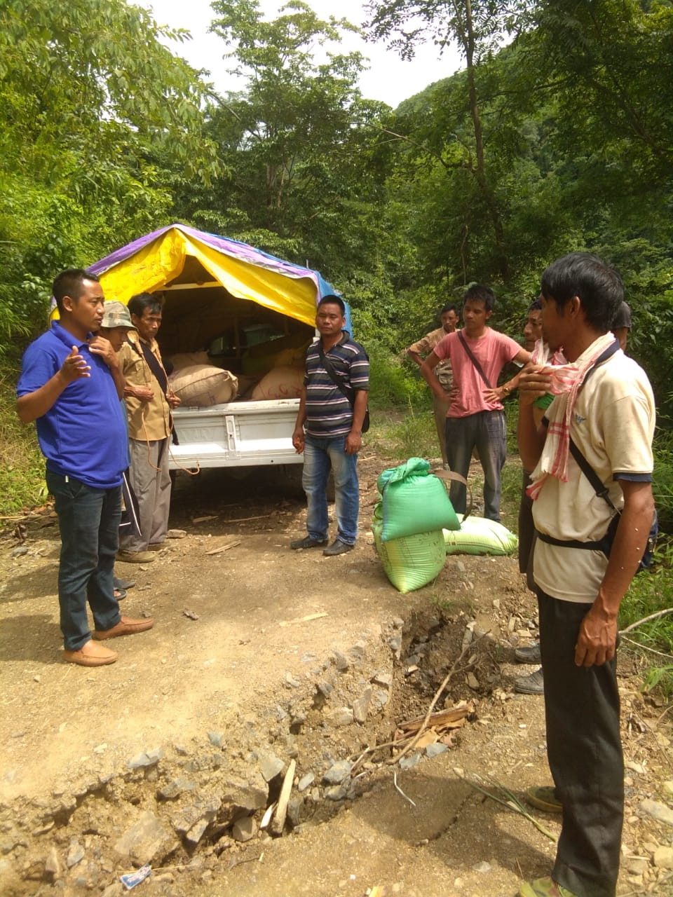
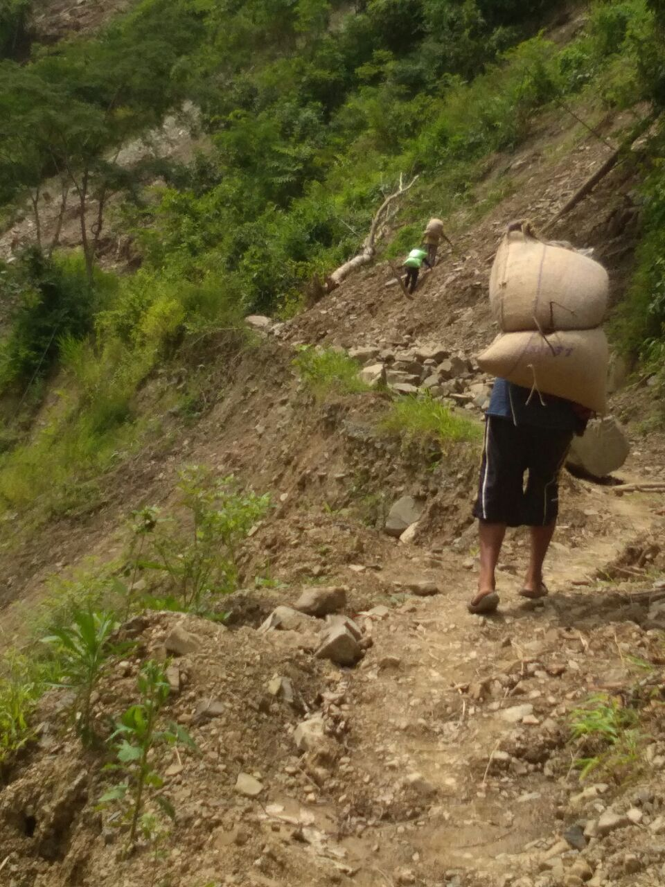
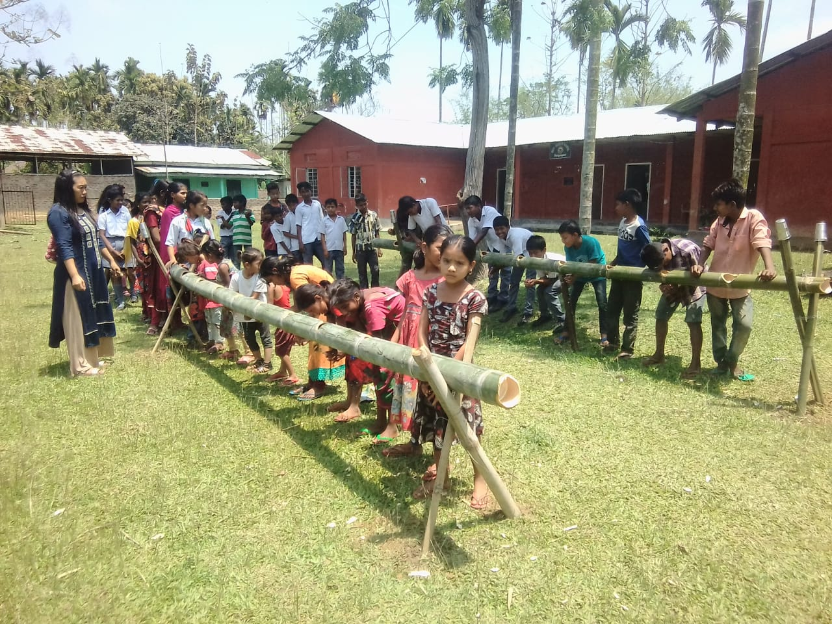
PPP – A Success Story!

Slide 9
Thank you

